Slide 1
Basic Electrical and Electronics Engineering
Dr. Sonam Shrivastava/ Assistant Professor (Sr.) /SELECT
LECTURE 1.3

Slide 2
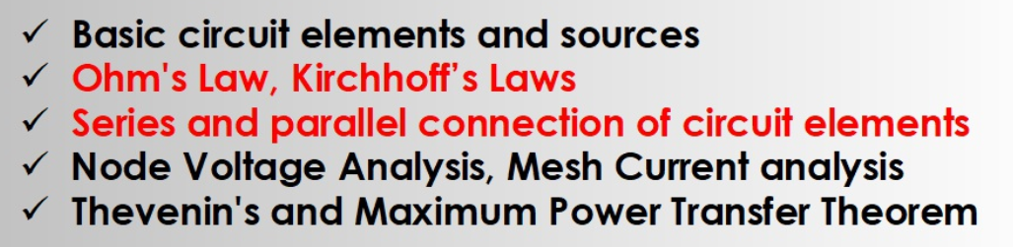
Module I. DC Circuits
Source transformation

Slide 3
Kirchhoff’s Laws
Kirchhoff’s Current Law (KCL):
The algebraic sum of all the currents entering any node in a circuit equals zero. (An expression of the conservation of charge.)
Kirchhoff’s Voltage Law (KVL):
The algebraic sum of all the voltages around any loop in a circuit equals zero. (As a result of conservation of energy.)

Slide 4
Kirchhoff’s current Law
The algebraic sum of all the currents entering any node in a circuit equals zero. (An expression of the conservation of charge.)
The algebraic sum of all the currents leaving any node in a circuit equals zero.
Sum of all the incoming currents = Sum of all the outgoing currents.
Reference direction conventions:
Treat all outgoing currents as +ve
Treat all incoming currents as -ve

Slide 5
Using Kirchhoff’s Current Law (KCL)
Consider a node connecting several branches:
i₂
i₃
i₁
i₄
Use reference directions to determine whether currents are “entering” or “leaving” the node – with no concern about actual current directions

Slide 6

KCL example

Slide 7
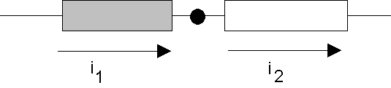
A Major Implication of KCL
KCL tells us that all of the elements in a single branch carry the same current.
We say these elements are connected in series.
Current entering node = Current leaving node
i₁ = i₂

Slide 8
Formulations of Kirchhoff’s Voltage Law
(Conservation of energy)
Algebraic sum of voltage drops around loop = 0
Reference direction conventions:
Treat all voltage drops as -ve
Treat all voltage gains as +ve

Slide 9
Using Kirchhoff’s Voltage Law (KVL)
Consider a branch which forms part of a loop:
+
v₁
_
–
v₂
+
voltage
“drop”
voltage
“rise”
(negative drop)
loop
loop
Use reference polarities to determine whether a voltage is dropped – with no concern about actual voltage polarities

Slide 10
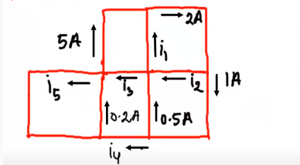

Find $i_{1}$, $i_{2}$, $i_{3}$, $i_{4}and$ $i_{5}$

Slide 11
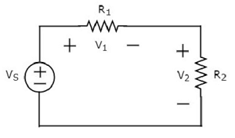
KVL Example

Slide 12
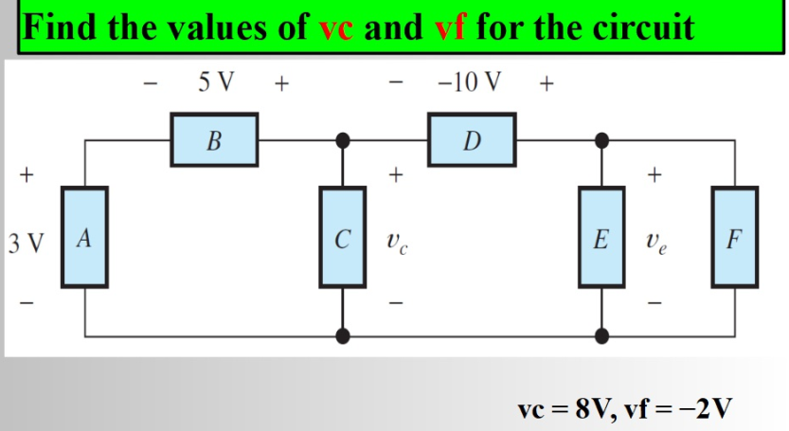
KVL Example

Slide 13
KVL Example

Slide 14
KVL Example
Three closed paths:
v₂
b
v₃
a
+ −
+ −
c
1
2
+
−
+
+
−
v_{a}
v_{b}
v_{c}
-
Path 1:
Path 2:
Path 3:
3

Slide 15
